Slide 1
Market Update: Current Deal Activity, Valuations and Outlook
Moderator: Mike Abbott, Partner, Faegre Baker Daniels
Mike Clausman, Hormel Foods Corporation
Adam Claypool, Bridgepoint Merchant Bank
Scott Hebbeler, Lincoln International
Melanie Wadsworth, Faegre Baker Daniels
Notes:
What songs best describes the market right now? (Do we need permission for this? Mike is asking directly…) SC 7.28.15

Slide 2

Conference Information
QUESTIONS?
Email questions for our panelists to
MAconference@FaegreBD.com
DISCUSS
#MACon15
Email Questions to MAConference@FaegreBD.com

Slide 3
Middle-Market M&A Overview
Market multiples now exceed peak levels while M&A volume continues to build
Middle-Market M&A Transaction Count
Average EV/EBITDA in U.S. Middle-Market Transactions
Source: Factset Mergerstat
Note: Reflects deals up to $500mm with disclosed values
Source: Factset Mergerstat
Note: Reflects deals up to $500mm with disclosed values
Email Questions to MAConference@FaegreBD.com

Slide 4
Middle-Market M&A Valuations
The chart illustrates valuation multiples of private equity-sponsored, middle-market* M&A transactions by transaction size since 2011.
Transaction multiples are at their highest levels since 2011, with the $100-250mm transaction size range leading the way at 8.3x.
Source: GF Data, M&A Report May 2015
*Note: middle market is $10 -$250mm

Slide 5
Middle-Market M&A Valuations by Industry
The charts below illustrate valuation multiples of private equity-sponsored, middle-market* M&A transactions by industry and transaction size since 2011.
Source: GF Data, M&A Report May 2015
*Note: middle market is $10 -$250mm

Slide 6
M&A Drivers
Corporate Cash On Hand
Private Equity Buyout Fundraising / Investing
($ in billions)
($ in billions)
Source: Federal Reserve, represents the S&P 500 companies
Source: Pitchbook
Email Questions to MAConference@FaegreBD.com

Slide 7
M&A Drivers
Private equity capital raised has increased from a total of $112B in 2011 to $223B and $197B in 2013 and 2014, respectively.
Private Equity U.S. Fundraising by Quarter
Private Equity U.S. Investments-to-Exits Ratio
Source: Pitch Book & Renaissance Capital
*YTD 2015

Slide 8

Quarterly Midwest M&A Transaction Volume
Bridgepoint Midwest M&A Quarterly Update, Q2-15
Midwest M&A transaction volume in Q2-15 rebounded nearly 20% from Q1-15
Midwest M&A transaction volume has been very stable 7 of the last 10 quarters
Midwest activity doesn’t necessarily track national activity over the same time period represented by this chart
Source: Bridgepoint Merchant Banking, Capital IQ (07/23/15), www.axial.net, www.bloomberg.com, www.qz.com, www.themiddlemarket.com

Slide 9
Quarterly Midwest M&A Median Deal Size
Bridgepoint Midwest M&A Quarterly Update, Q2-15
Midwest M&A deal size grew to $19.0mm in Q2-15, up from $16.5mm in Q1-15
After recording one of the lowest median deal size in Q1-15, Q2-15 saw Midwest deal sizes increased to above average level of the past 4 years
Source: Bridgepoint Merchant Banking, Capital IQ (07/23/15), www.axial.net, www.bloomberg.com, www.qz.com, www.themiddlemarket.com
Email Questions to MAConference@FaegreBD.com

Slide 10
Quarterly Midwest M&A Median Valuations (TEV/EBITDA)
Bridgepoint Midwest M&A Quarterly Update, Q2-15
Median Valuation (TEV/EBITDA) in Q2-15 was significantly higher than both the prior sequential quarter and the year-earlier quarter
Q2-15 multiples are at historically strong levels, the highest since Q2-13
Corporates and sponsors have shown a willingness to pay a premium to close deals
Source: Bridgepoint Merchant Banking, Capital IQ (07/23/15), www.axial.net, www.bloomberg.com, www.qz.com, www.themiddlemarket.com
Email Questions to MAConference@FaegreBD.com

Slide 11
Quarterly Midwest M&A Buyers & Sellers
Bridgepoint Midwest M&A Quarterly Update, Q2-15
Quarterly M&A transactions with Midwest buyers increased from 145 in Q1-15 to 166 in Q2-15
The number of transactions with Midwest targets increased as well with 135 announced or closed transactions in Q2-15 vs. 97 in Q1-15. The figures reiterate the strong buyer appetite for Midwest companies
Source: Bridgepoint Merchant Banking, Capital IQ (07/23/15), www.axial.net, www.bloomberg.com, www.qz.com, www.themiddlemarket.com
Email Questions to MAConference@FaegreBD.com

Slide 12
Q2-15 Midwest M&A Transaction Volume by Sector
Bridgepoint Midwest M&A Quarterly Update, Q2-15
Core industries (including Industrials, Materials and Consumer) accounted for 39% of total Midwest M&A transaction volume in Q2-14, a slight 1% decrease from Q1-14
The Consumer sector rebounded with the biggest increase in Q2-14, up 3% from Q1-14. The Material and Industrial sectors saw the biggest decreases in Q2-14, down 2% from Q1-14
Source: Bridgepoint Merchant Banking, Capital IQ (07/23/15), www.axial.net, www.bloomberg.com, www.qz.com, www.themiddlemarket.com
Email Questions to MAConference@FaegreBD.com

Slide 13
Overview of U.S. Middle Market Debt Pricing and Terms
Lincoln’s View on Pricing and Terms
 | Borrowers with less than $15mm EBITDA |  | Borrowers with at least $15mm EBITDA
 | Pricing | Multiples | Pricing | Multiples
Asset Based Senior | L + 175 – 275 LIBOR Floor: none | N/A | L + 150 – 250 LIBOR Floor: none | N/A
Cash Flow Senior | L + 475 – 575 LIBOR Floor: 100 | 2.75x – 3.25x EBITDA | L + 425 – 525 LIBOR Floor: 100 | 3.00x – 4.00x EBITDA
Senior Stretch | Unlikely | N/A | L + 500 – 600 LIBOR Floor: 100 | 3.75x – 4.75x EBITDA
Unitranche | L + 750 – 850 LIBOR Floor: 100 | 4.00x – 5.00x EBITDA | L + 700 – 800 LIBOR Floor: 100 | 4.00x – 6.00x EBITDA
2nd Lien Loans | Unlikely | 4.00x – 5.00x EBITDA | L + 850 – 1000 LIBOR Floor: 100 | 4.00x – 6.00x EBITDA
Sub Debt | Cash of 11.0% – 13.0% PIK of 1.0% – 2.0% All-in of 12.0% – 14.0% | 4.00x – 5.00x EBITDA | Cash of 10.0% – 11.0% PIK of 1.0% – 2.0% All-in of 11.0% – 13.0% | 4.00x – 6.00x EBITDA
Equity | N/A | Approximately 35% | N/A | Approximately 30% – 35%
As regularly published in:
Email Questions to MAConference@FaegreBD.com

Slide 14
Current Trends in Senior Debt Structure
Pre 2008
2008 - 2009
2015
Hold Levels
$50 million
$25 million max
$50 million +
Stretch Pieces
Aggressive
Nonexistent
Yes
Term Loan Amortization
Little or none
Nearly a prerequisite
Little or back-end loaded
Covenants
Limited to 1 or 2 and loose
Full package, much tighter
1 to 2 covenants; looser
Advance Rates
Aggressive (ABL-Lite)
Conservative (ABL-Heavy)
Aggressive (ABL-Lite)
Rate Floors
Rare
Standard
Rare
Rate Protection Language
Minimal
Robust and complex
Robust and complex
Prepayment Penalties
Rare
Standard
Rare
Bank Commitment
Fully underwritten
Best efforts
Best efforts
Market Flex Language
Limited, if any
Required
Required
Bank Group
Syndications
Relationship driven "Club Deals"
Syndications

Slide 15
Favorable Debt Financing Environment
Competition among lenders have driven the strongest lending markets since 2007
Middle-Market Leverage Multiples
Middle-Market M&A Loan Volume
($ in billions)
  2009: $1.4
  2010: $4.4
  2011: $6.3
  2012: $5.6
  2013: $4.8
  2014: $9.5
Source: Standard & Poor’s Leveraged Commentary and Data
Email Questions to MAConference@FaegreBD.com

Slide 16
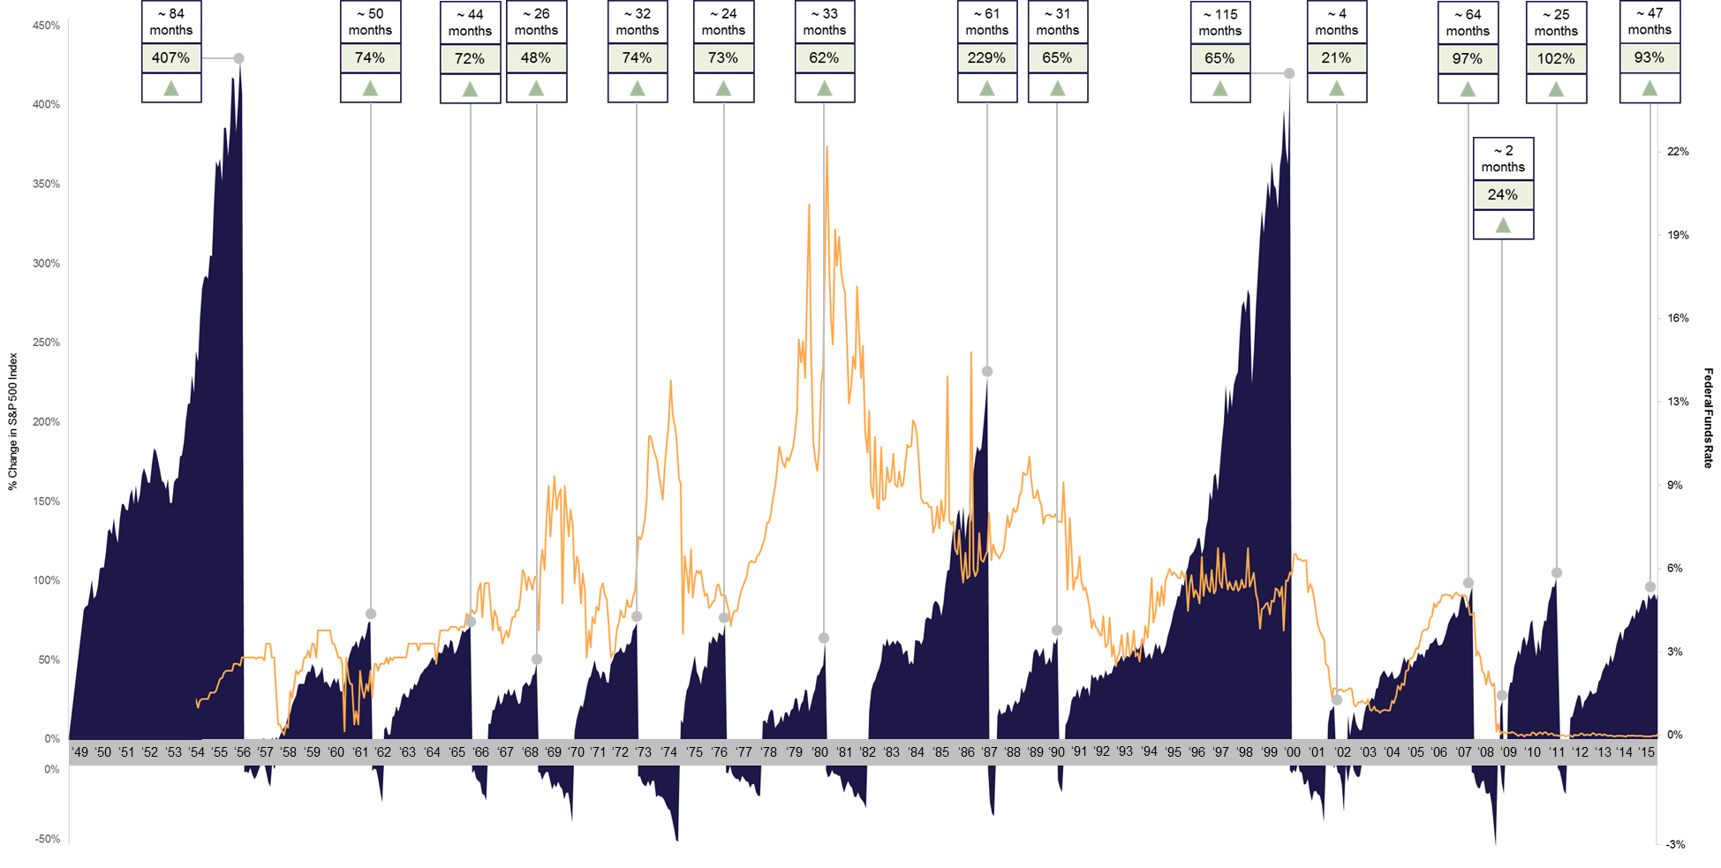
Historical S&P 500 Index Relative to Federal Funds Rate
Bull vs. Bear Markets
Since 1949, the average length of bull markets has been 42.5 months
The current bull market has lasted 47 months to date
Historically, bull markets end due to:
    High equity valuations
    Tight monetary policy
    Unforeseen geopolitical events
Source: Bridgepoint Merchant Banking, Capital IQ (07/23/15), www.axial.net, www.bloomberg.com, www.qz.com, www.themiddlemarket.com
Email Questions to MAConference@FaegreBD.com

Slide 17
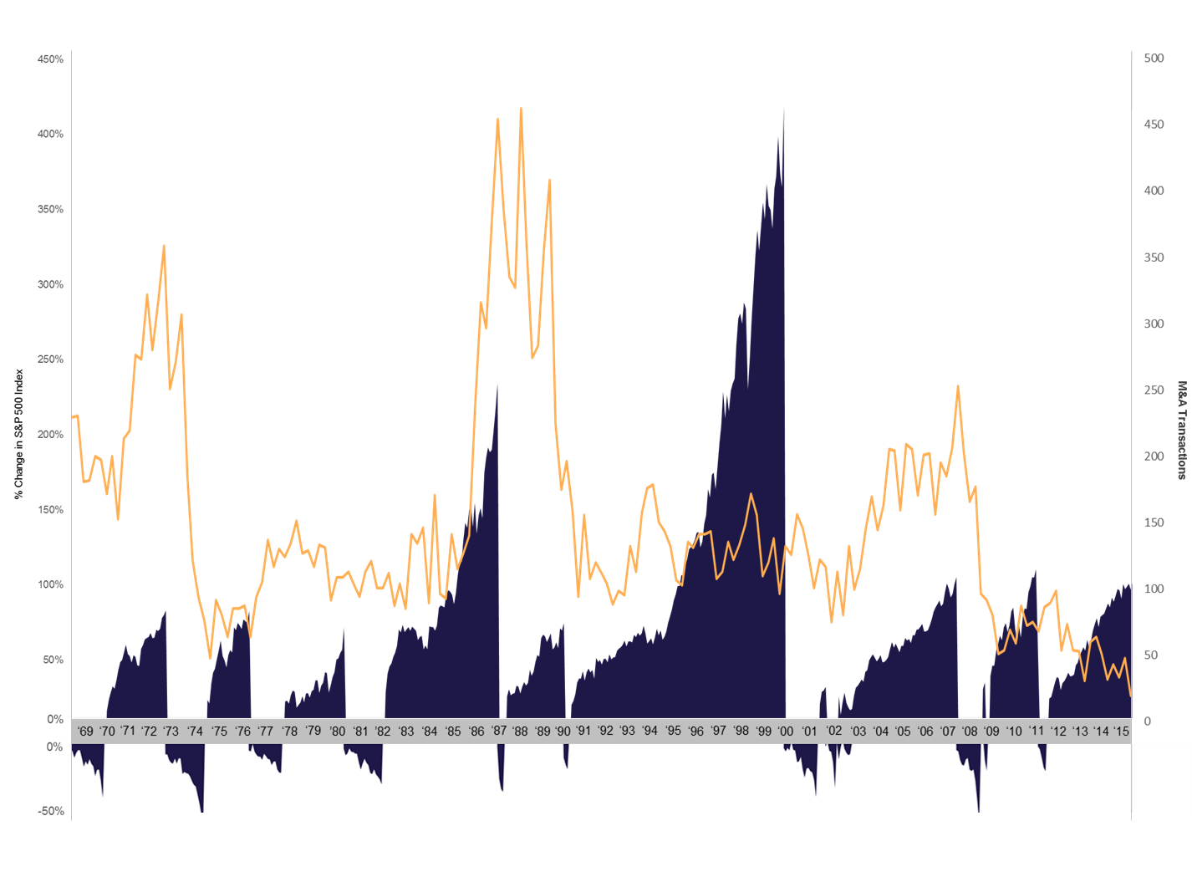


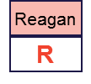
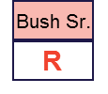

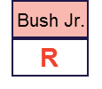
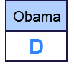
Historical S&P 500 Index Relative to M&A Transactions
Presidential Election Years
Since the 1968 election, 6 out of 12 election years were followed by a bear market within one year
Average M&A transactions during Republican terms are 20,346
Average M&A transactions during Democratic terms are 8,553
Source: Bridgepoint Merchant Banking, Capital IQ (07/23/15), www.axial.net, www.bloomberg.com, www.qz.com, www.themiddlemarket.com
Email Questions to MAConference@FaegreBD.com

Slide 18
Predictions for 2015-2016

